Slide 1
Oil Spill Analysis
By
Courtney Sanders

Slide 2
Agenda
Methods
Research Question
Dataset
Hypotheses 1 & 2
T-test Visuals-Statistical Analysis
Results
Recommendations/Call to Action

Slide 3
Methods
The following methods were utilized for the hypotheses:
Independent samples t-test
Utilization of bar and box plots
Python programming

Slide 4
Research Question
“What are the main factors of accidental oil spills and leaks, which increase costs?”
Why the question matters and should be of concern
The Audience

Slide 5
Dataset
Original Source
https://www.kaggle.com/usdot/pipeline-accidents
https://drive.google.com/file/d/18Ou7wTp1NDal0hLnwLczgQ-n_Hx5ENDG/view?usp=sharing – Excel file
Features, datatypes, & rows
Variables chosen

Slide 6
Hypothesis 1
The following are the hypotheses developed for the oil spill analysis:
Ho: There is no significant financial impact to pipelines aboveground and underground
Ha: There is significant financial impact to pipelines aboveground and underground

Slide 7
Hypothesis 2
The following are the hypotheses developed for the oil spill analysis:
Ho: There is no significant financial impact for pipelines impacted by corrosion and material, welding, and/or equipment failure
Ha: There is significant financial impact for pipelines impacted by corrosion and material, welding, and/or equipment failure

Slide 8
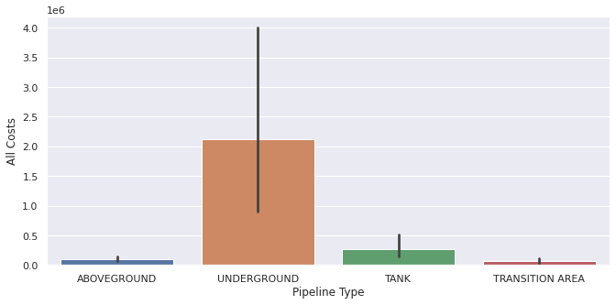
T-test Visual: Underground & Aboveground Pipelines (Bar Plot)
The following resulted after testing of the hypothesis:
T-test_indResult(statistic=2.768255038157586, p-value=0.005677990145938439)
The difference in means at the 95% confidence interval (two-tail) is between -3749157.9478498837 and -268646.41673068865

Slide 9
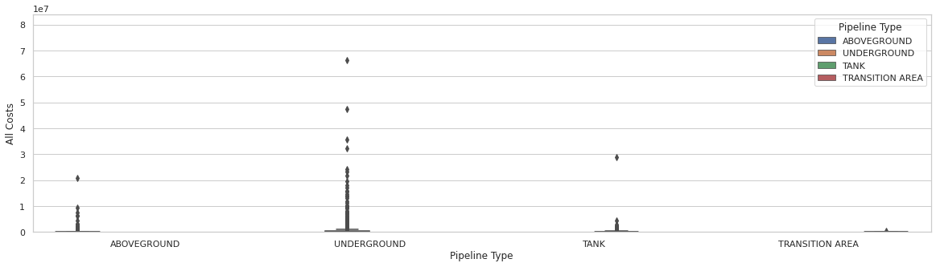
T-test Visual: Underground Aboveground & Pipelines (Box Plot)
Here is a different visual of the same results

Slide 10
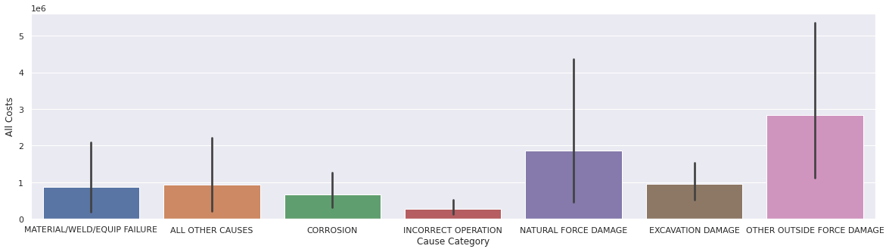
T-test Visual: Corrosion & Material/Weld/Equipment Failure(Bar Plot)
The following resulted after testing of the hypothesis:
Ttest_indResult(statistic=-0.21323198516968564, p-value=0.8311674856649588)
The difference in means at the 95% confidence interval (two-tail) is between -1058191.0297977468 and 1456114.8321543718.

Slide 11
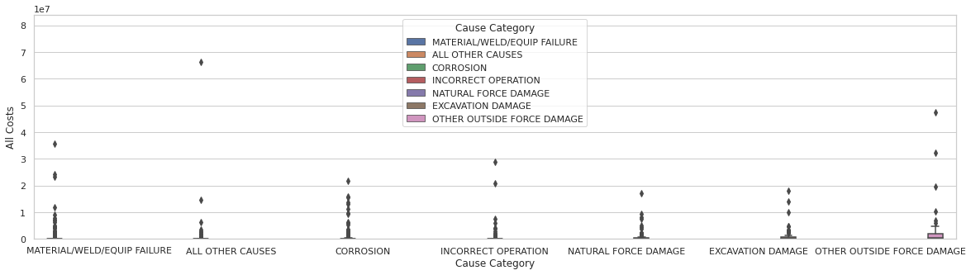
T-test Visual: Corrosion & Material/Weld/Equipment Failure(Box Plot)
Here is another visual of the same results

Slide 12
Results
Pipeline Test Data(Underground and Aboveground): There is significant impact to all costs regarding underground and aboveground pipelines from oil spills and/or leaks.
Cause Category Test Data(Corrosion and Material, Weld, and Equipment Failures): There is no significant impact to all costs by oil spills and/or leaks due to corrosion and material, weld, and equipment failures.

Slide 13
Recommendations/Call to Action
Invest in building more pipelines above the ground
Locate pipelines above the ground in different areas that are more environmentally safe and less accident prone
Present more restrictive safety regulations
Find economical ways to invest in drilling oil out in space away from Earth

Slide 14
Q & A

